Slide 1


CS-482: Introduction to Blockchain and CryptoCurrency
Lecture # 10: Bitcoin as a Platform

Slide 2
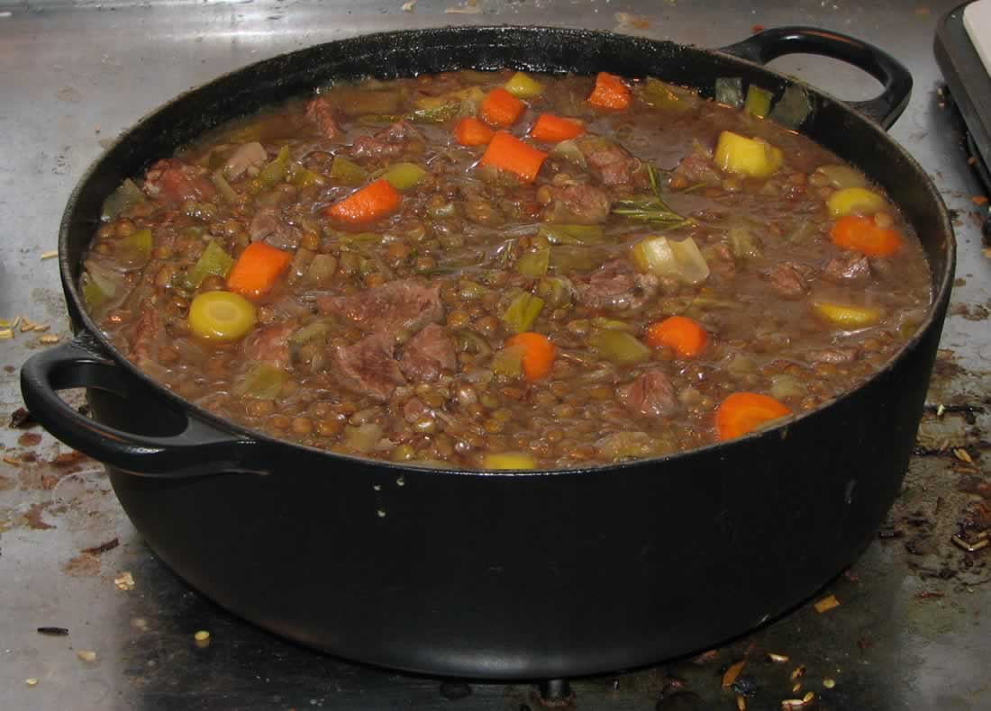
In this lecture
We’ve built Bitcoin. What can we build on top?
Commitments
Token tracking
Multiparty lotteries
Public randomness
Prediction markets
A fine stew o’ ideas

Slide 3
Bitcoin as an append-only log

Slide 4
Secure timestamping
Goal: Prove knowledge of x at time t
If desired, without revealing x at time t
Evidence should be permanent

Slide 5
Hash commitments
Recall: Publishing H(x) is a commitment to x
Can’t find an x’≠x later s.t. H(x’) = H(x)
H(x) reveal no information* about x
*assuming the space of possible x is big
Can publish a commitment to x, reveal later

Slide 6
Secure timestamping applications
Proof of knowledge
Proof of receipt
Hash-based signature schemes
many, many more...

Slide 7
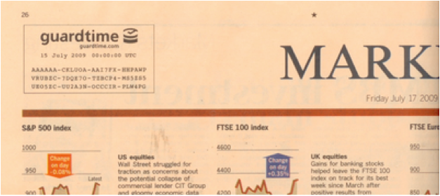
Offline solution: newspaper timestamp

Slide 8
Timestamping in Bitcoin
Idea: Specify the hash of your data instead of a valid public key
Send 1 satoshi to the address
Pros: compatible, easy
Cons: creates unspendable UTXO forever

Slide 9
Timestamping in Bitcoin: CommitCoin
Clark, Essex 2012
Idea: Brute-force a public key & signature starting with the first n bits of your data hash
Pros: compatible, “invisible”, no UTXO bloat
Cons: more expensive, low data rate

Slide 10
Bitcoins as “smart property”

Slide 11


Every bitcoin* carries a history
Coinbase
Coinbase
Bad for anonymity
Enables blacklisting
Observation: bitcoins aren’t fungible! Every one is unique
Can this property be useful?
*There are no “bitcoins”, just unspent tx outputs

Slide 12
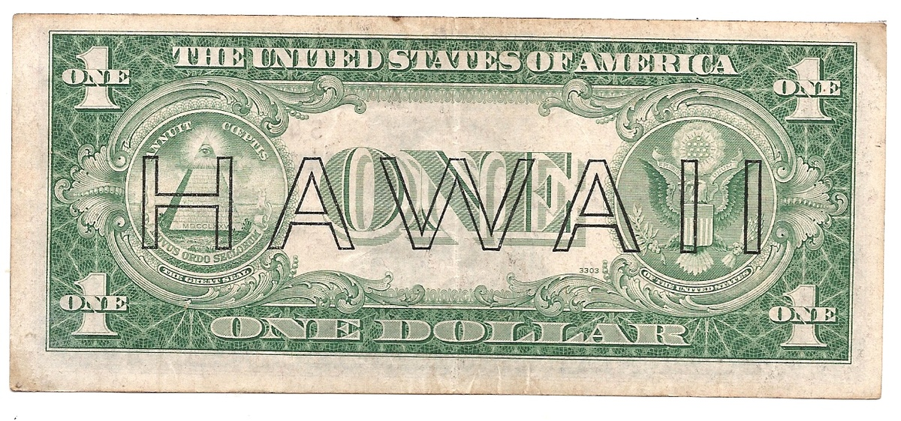
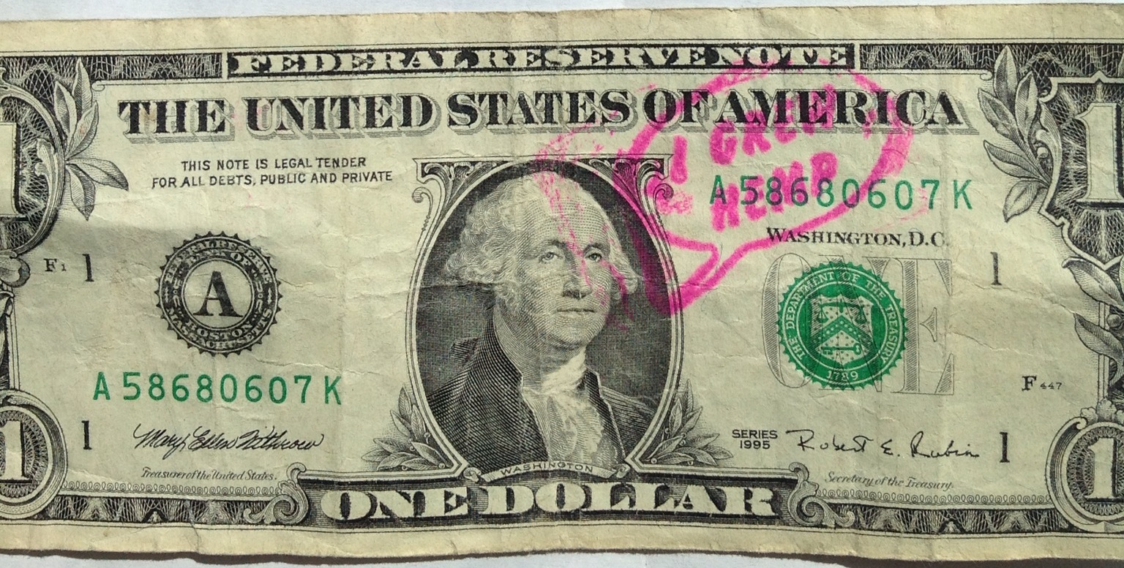
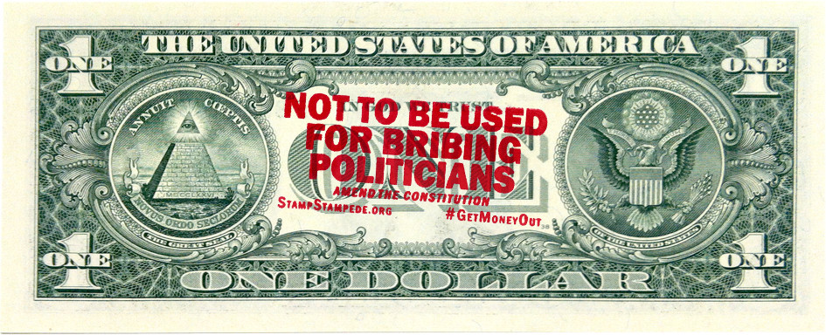
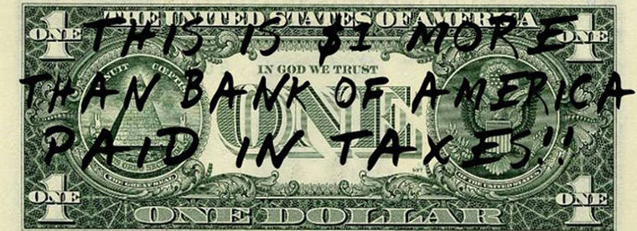
Adding metadata to currency
Without limitations on issuance, just a novelty

Slide 13
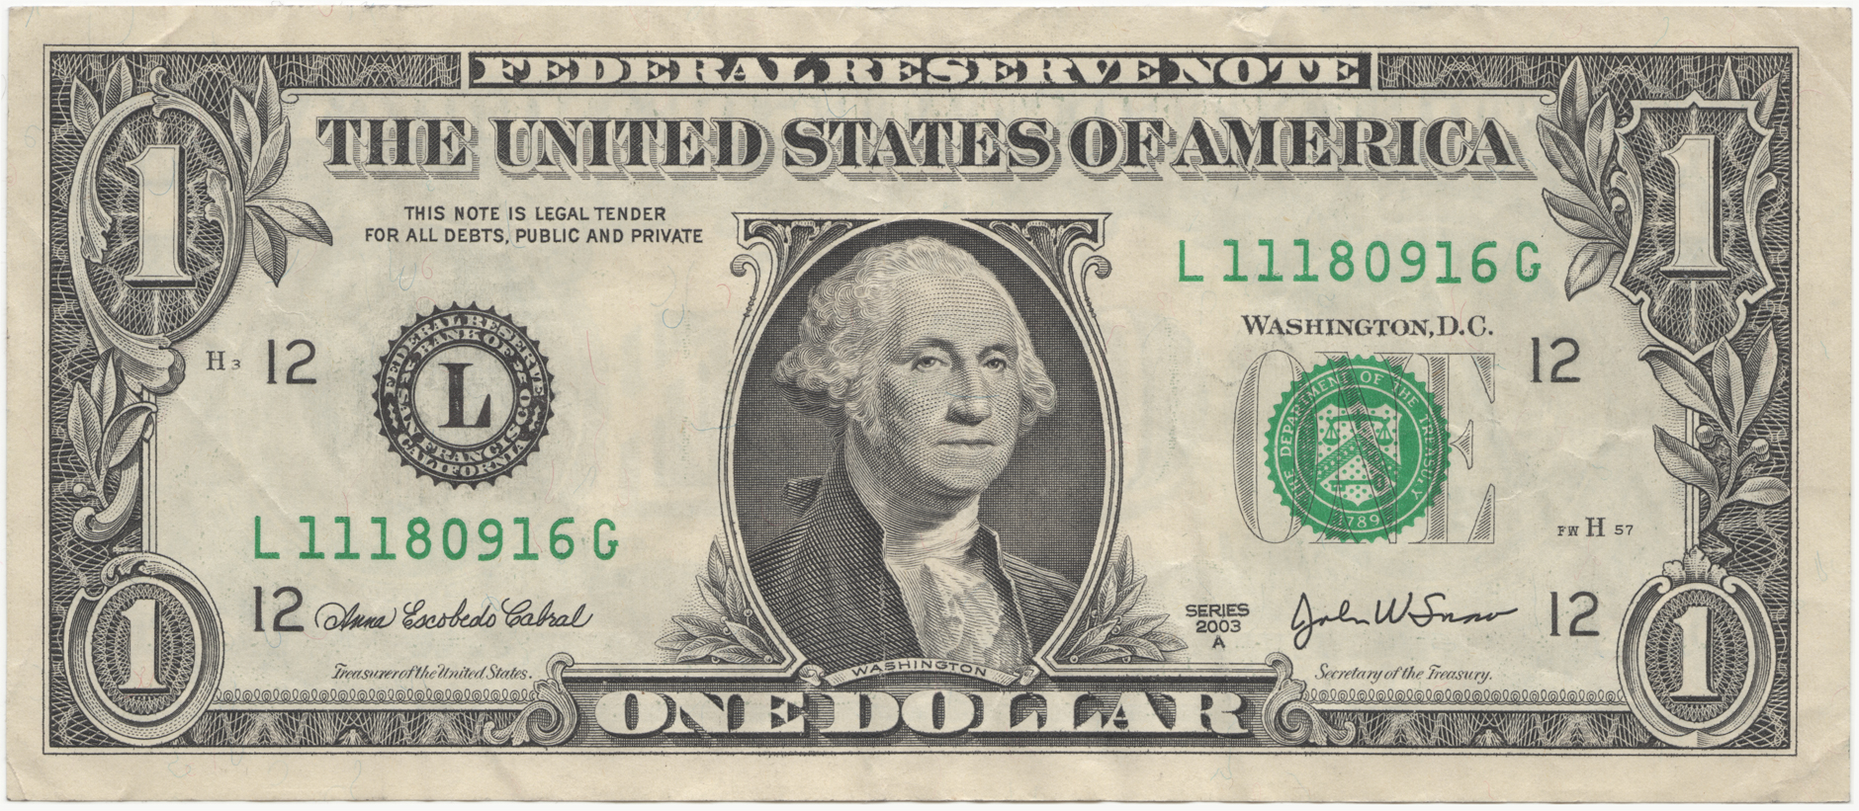
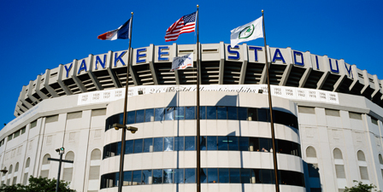

Authenticated metadata for currency
Idea: sign desired metadata + banknote serial #
“Bill #L11180916G hereby grants the holder admission to the Yankees game on Aug 18, 2014”
SIGN_{K}(M, #)
Stadium

Slide 14
Authenticated metadata for currency
Currency can now
represent anything!
Anti-counterfeiting
properties are inherited
Underlying value also maintained!
New meaning relies on trust in the issuer
Some users may not understand new metadata
Can we build this on top of Bitcoin?

Slide 15


Colored coins
12
ISSUE 4
ISSUE 5
4
9
5
7
4
5
9
ISSUE 9
3
1
9
5
13

Slide 16
Colored Coins
Pros
compatible with Bitcoin
flexible to represent any asset
ignored by community
Cons
small cost of unspendable markers
must check every previous tranasction

Slide 17
Applications
stock certificates
tickets
deeds to real-world property
houses?
cars?
ownership of domain names
NameCoin... stay tuned for our lecture on Altcoins!

Slide 18
Secure multi-party lotteries in Bitcoin

Slide 19


Real-world lotteries without trust*
*The outcome is fair, but both parties have to trust the other will actually pay up
Sure, I’ll take heads!
Wanna bet $5
Alice
Bob

Slide 20
Online lotteries without trust?
But I can’t see your coin!
I’ll bet $5 on heads!
Network
Alice
Bob
Problem: Alice and Bob want to bet on a coin flip remotely

Slide 21
Hash commitments
Recall: Publishing H(x) is a commitment to x
Can’t find an x’≠x later s.t. H(x’) = H(x)
H(x) reveal no information* about x
*assuming the space of possible x is big

Slide 22

A lottery with hash commitments
Round 1
Round 2
time
Choose random x
Alice
Publish H(x)
Publish x
Hash function guarantees nobody can win with probability more than 1/3
w= H(x⊕y⊕z) % 3
switch (w){
case 0:
winner = Alice;
case 1:
winner = Bob;
case 2:
winner = Carol;
}
Choose random y
Bob
Publish H(y)
Publish y
Choose random z
Carol
Publish H(z)
Publish z

Slide 23
Failure to reveal commitment
Round 1
Round 2
time
Sorry! I, uhh, forgot z
Not cool Carol ☹
Choose random x
Alice
Publish H(x)
Publish x
w= H(x⊕y⊕z) % 3
switch (w){
case 0:
winner = Alice;
case 1:
winner = Bob;
case 2:
winner = Charlie;
}
I’m about to lose...
Sorry! I, uhh, forgot z
Choose random y
Bob
Publish H(y)
Publish y
Choose random z
Ø
Carol
Publish H(z)

Slide 24
Timed hash commitments
Idea: Force x to be revealed by time t
Input: ...; Pay B to EITHER OF:
Alice & Bob, or
Alice & anybody who knows x st. H(x) = c
SIGNED(Alice)
1
MULTISIG
Bond
New script!
Bob can claim the bond at time t
Input: 1; Pay B to Bob:
n_lock_time: t
SIGNED(Alice) SIGNED(Bob)
2
x revealed if Alice reclaims her bond
Input: 1; Pay B to Alice:
SIGNED(Alice), x
3

Slide 25
Lottery with timed commitments
Round 1
Round 2
time
Choose random x
Timed commitment to H(x)
Alice
Publish x
w= H(x⊕y⊕z) % 3
switch (w){
case 0:
winner = Alice;
case 1:
winner = Bob;
case 2:
winner = Carol;
}
I’m about to lose...
Choose random y
Bob
Timed commitment to H(y)
Publish y
But I’ll lose my bond if I don’t publish ☹
Choose random z
Timed commitment to H(z)
Carol

Slide 26
Lottery with timed commitments
Pros:
can be implemented on Bitcoin today
Andrychowicz, Dziembowski, Malinowski, Mazurek 2014
Cons:
complexity is O(N²)
bonds must be higher than amount bet
griefers still might shut down large pools

Slide 27

Cryptographic beacons
Idea: service to regularly publish random data
Uniform randomness
No party can predict in advance
All parties see the same values
01010001 01101011 10101000 11110000 10010100
Applications: lotteries, auditing, zero-knowledge proofs, cut-and-choose, ...

Slide 28
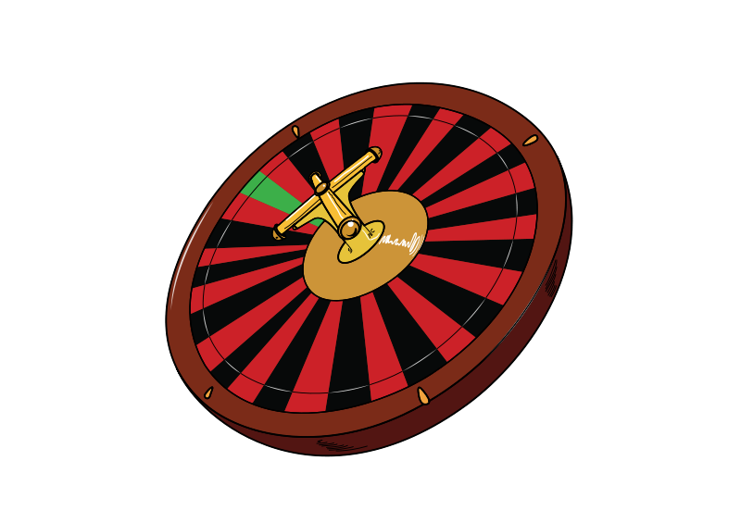
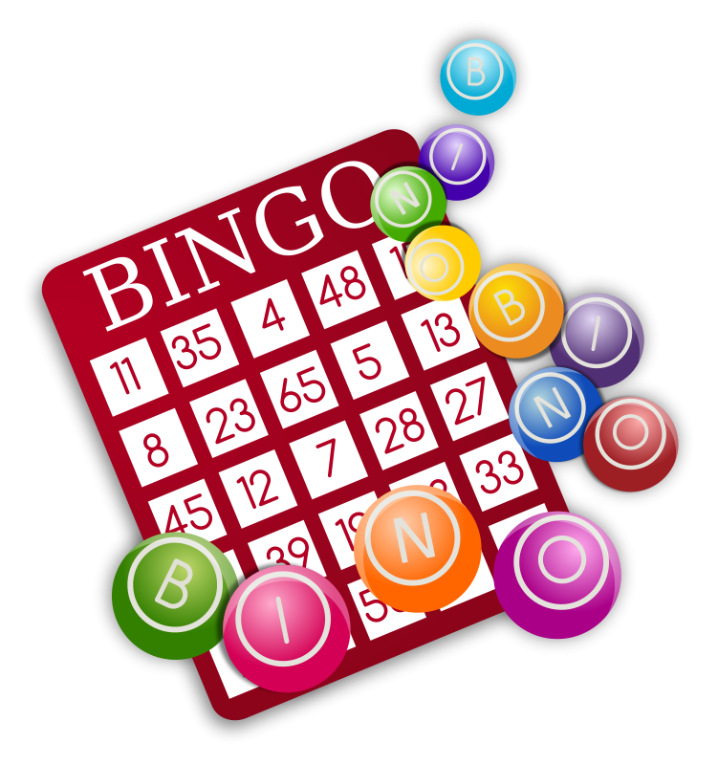


Public display of randomness
Pros: cheap, easy, simple to understand
Cons: must trust/audit operator
hard to trust remotely!

Slide 29
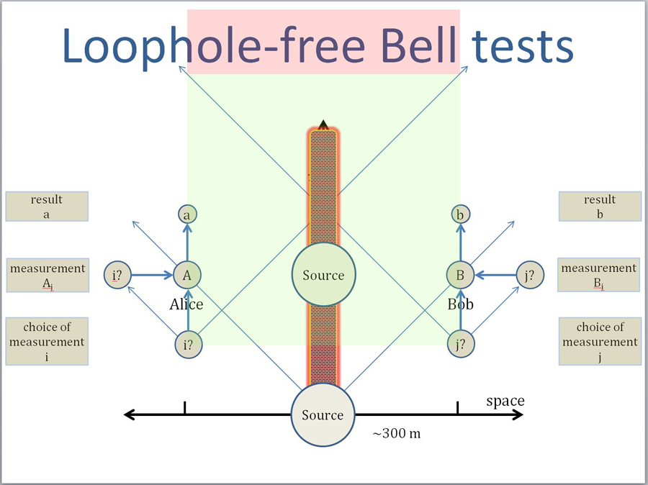
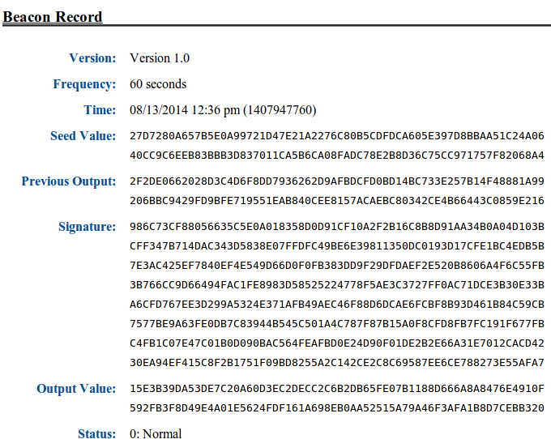
NIST beacon
Pros: quantum-mechanical randomness
Cons: must trust NIST
Notes:
heisenberg uncertainty principle
the position and the velocity of an object cannot both be measured exactly, at the same time, even in theory

Slide 30


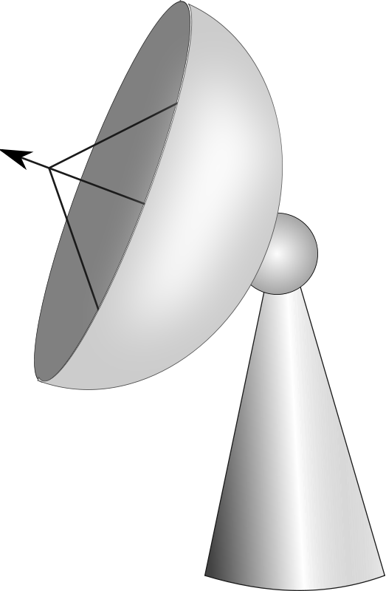
Natural phenomena
Cosmic background radiation
Sun spots
Weather
Pros: publicly observable, random
Cons: slow, need a trusted observer?

Slide 31
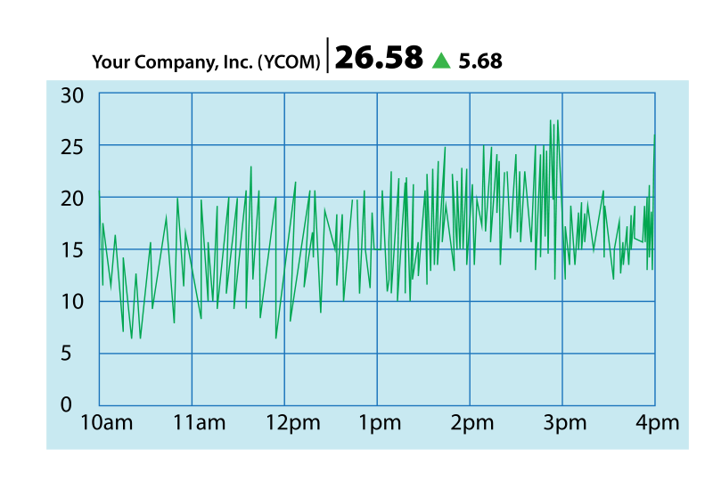
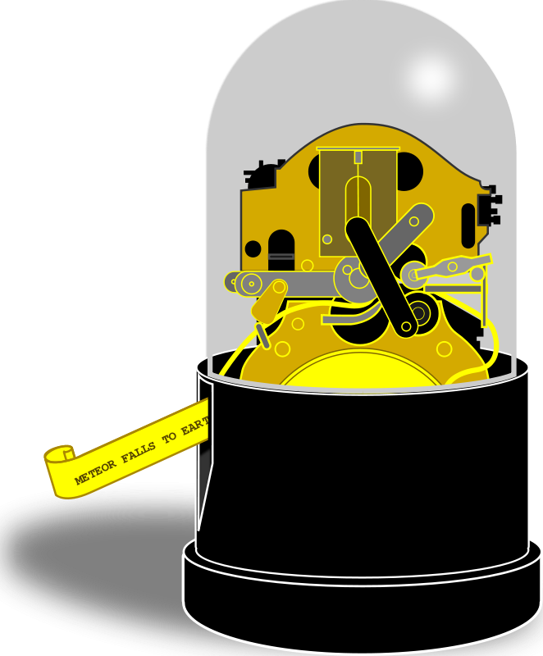

Stock-market beacon
Pros: good randomness, costly to manipulate
Cons: slow, insider attacks?

Slide 32
Why not use the block chain?
Recall: miners find random nonce for each block
If you could predict the next nonce with a greater than 1/d probability, you’d have a mining shortcut
Currently, d > 2⁶⁶

Slide 33
Turning the block chain into a beacon
prev: H( )
prev: H( )
prev: H( )
mrkl_root: H( )
mrkl_root: H( )
mrkl_root: H( )
nonce: 0x0001...
nonce: 0xffff...
nonce: 0x0000...
nonce: 0x0001...
nonce: 0x0002...
nonce: 0xf77e...
nonce: 0x0001...
nonce: 0xffff...
nonce: 0x0000...
nonce: 0x0001...
nonce: 0x0002...
nonce: 0x7a83
nonce: 0x0000...
nonce: 0xf77e...
nonce: 0x0000...
hash: 0xd0c7...
hash: 0xd0c7...
hash: 0x6a1f...
hash: 0x300c...
hash:
hash: 0x0224...
hash: 0xc9c8...
hash: 0x0000...
hash: 0x6a1f...
hash: 0x300c...
hash:
hash: 0x0224...
hash: 0xc9c8...
hash: 0x3485...
hash: 0x0000...
hash: 0x0000
hash:
hash: 0x3485...
hash:
Extract
Extract
Extract
01010001 10101000 10010100

Slide 34
Cost of manipulation
Attacker might mine a block but discard it
Or bribe other miners to do so
Bernoulli trials: forcing a beacon outcome with probability p requires discarding 1/p - 1 blocks
Discarding a block “costs” 12.5 BTC

Slide 35
Cost of manipulation
Single coin flip: secure if wager is < 12.5 BTC
N-party lottery: secure if pool is < 12.5 (n-1) BTC

Slide 36
Pros
First proposal for fully decentralized beacon
Output every 10 minutes
Can precisely analyze manipulation costs
Can extend security with multiple blocks
Not very efficient

Slide 37
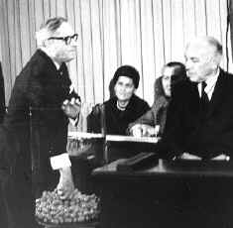
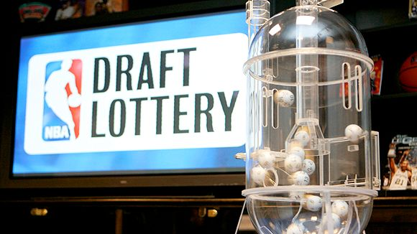
Cons
Timing is imprecise
Block chain not synchronized w/ real time
Need to delay to insure against forks
Manipulation may be too cheap for some applications

Slide 38
Built-in beacon support in script
Idea: add an opcode for a beacon call
Can build multi-party lotteries
only one round
no bonds
no time delay for refunds

Slide 39
Prediction markets
Idea: trade shares in a potential future event
Shares worth X if the event happens, 0 if not
Current price / x = estimated probability

Slide 40





Example: World Cup 2014
pre-tournament
0.12 0.09 0.22 0.01 0.05
after group stage
0.18 0.15 0.31 0.06 0.00
0.26 0.21 0.45 0.00 0.00
before semis
Can immediately profit!
before finals
0.64 0.36 0.00 0.00 0.00
final
1 0 0 0 0
Should have shorted

Slide 41
Short History of Altcoins
Chapter 10

Slide 42
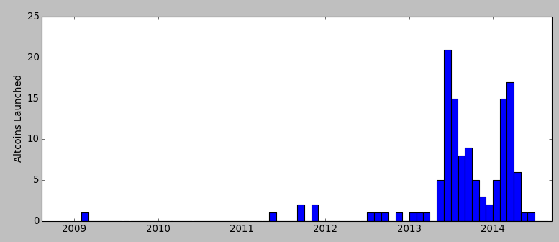
Bitcoin is not alone
Data from mapofcoins.com
Between 500-1000 altcoins launched to date
Dogecoin
Altcoins launched per month
(genesis block)
Litecoin
Namecoin
Peercoin
Bitcoin

Slide 43
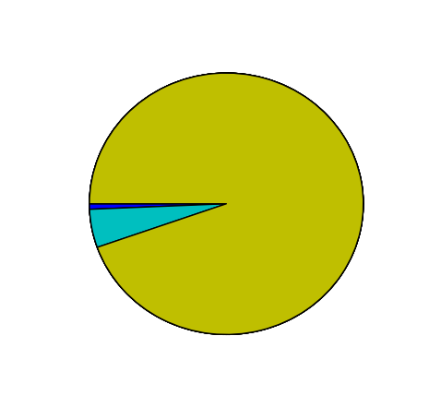
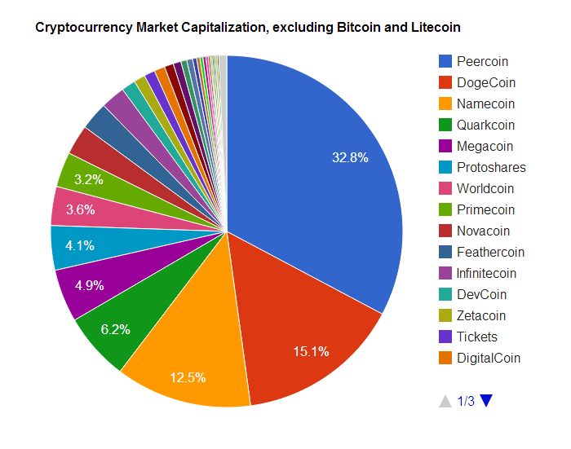
Bitcoin and Litecoin are 99% of total
based on Market Cap (price * total)
Bitcoin (94%)
Others (1%)
Litecoin (5%)
data from Jan 2014
cryptostat.com and bitinfocharts.com

Slide 44
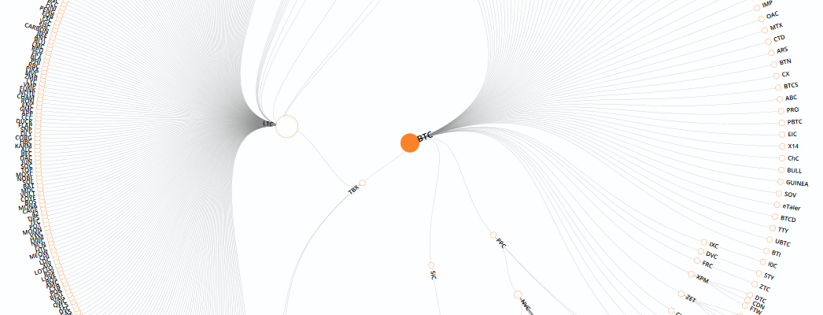
Altcoin genealogy
Litecoin
Bitcoin
Tenebrix
Peercoin
Graphic from mapofcoins.com

Slide 45
Features of altcoins
Better (or different) security
Mining puzzle
Contract/platform features
Different parameters and monetary policy
inflation
inter block time
Community or common interest support

Slide 46

Namecoin
First altcoin (launched in April 2011)
Feature: Domain Name Registration
http://example.bit/
New name costs 0.01 NMC (about 1 cent US)
No renewal fee: must “ping” every 6 months
Names (and subdomains) can be transferred/sold
Can be “merge-mined” with Bitcoin - defined later

Slide 47

Litecoin
Litecoin launched in Sep. 2011
Memory-hard mining puzzle
Intended to be GPU-resistant,
when Bitcoin mining was GPU-based
FPGA, ASICs, arrived but later than BTC
4th most popular, 1st most widely forked
Block rate is 4x faster

Slide 48

Peercoin (aka PPCoin)
Launched August 2012
Hybrid mining:
First Proof-of-Stake algorithm
mine by spending “stake” which accumulates
Proof-of-Work can earn mining rewards
… but aren’t counted for choosing the main chain
Also uses regularly published “checkpoints”
acts as a safeguard, planned to remove in future

Slide 49


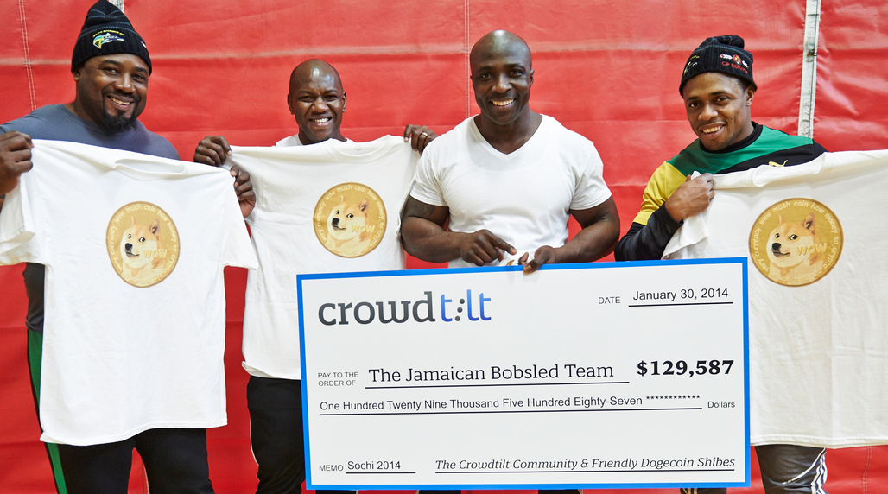
Dogecoin: Culture
Launched in December 2013
Culture - tipping, charity, sponsorship
Notes:
I probably don’t have copyright for any of these two images so I have to delete them. I couldn’t find good alternatives.

Slide 50
Dogecoin: “Random” block rewards
Goal: each block bonus is “random”
Implementation: block bonus is pseudorandom function of previous block hash
Problem: miners know next reward in advance
switch to other altcoin when reward is low
Feature removed in March 2014

Slide 51
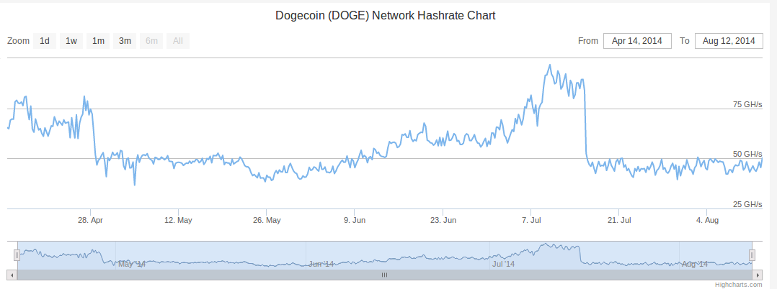
Dogecoin: Mining reward half-life
Mining reward cut in half every two months
Halved
Halved

Slide 52
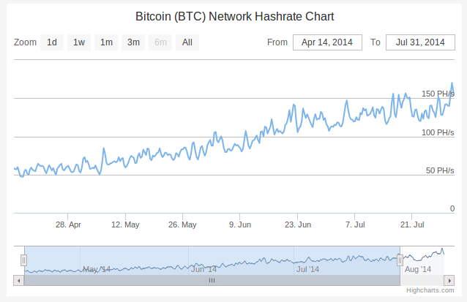
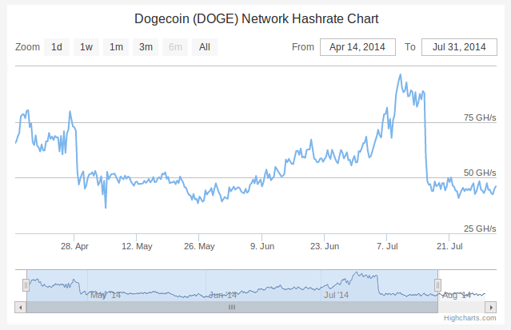
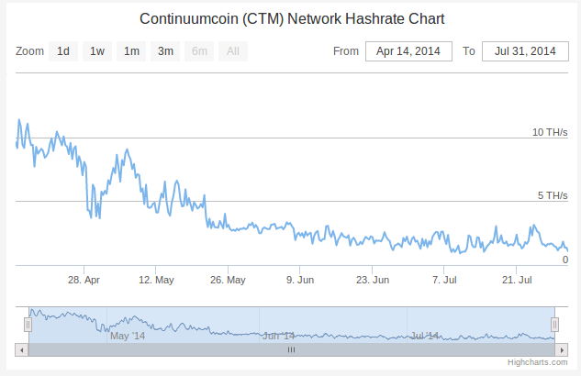
Compare altcoins:
Hashrate/time
Bitcoin Hashrate
Dogecoin Hashrate
{Declining Altcoin} Hashrate

Slide 53
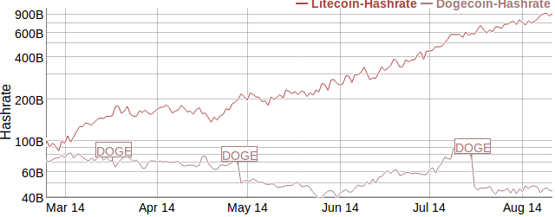
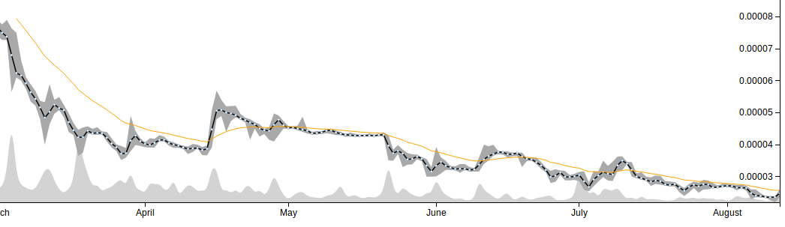
Compare altcoins:
Hashrate and
price change
Dogecoin vs. Litecoin Price (Cryptsy)

Slide 54
Metrics for comparing altcoins
Market cap (price * total number of coins)
Overestimates value (but by how much?)
Doesn’t account for lost / out-of-circulation coins
Exchange volume
Depends on nature of third party exchanges
Can be moved deliberately
Total hashpower (for similar puzzles)
Merchant support and usage?

Slide 55
Interaction between Bitcoin and altcoins

Slide 56
Mining attacks
Even a small miner (or mining pool) on a large network can demolish a small altcoin
Attacks like this have happened before:
Jan 2012: CoiledCoin - by Eligius pool
Jul 2013: TerraCoin - unknown
Nov 2013: WorldCoin - unknown
Notes:
terracoin: https://bitcointalk.org/index.php?topic=261986.0
world coin: http://worldcoinforum.org/topic/456-confirmed-51-attack-double-spend-attack-on-worldcoin/

Slide 57
Merge mining
Ordinarily, mining is exclusive
Each attempt either has a chance to be a Bitcoin block,
or has a chance to be an Altcoin block
Obstacle to bootstrapping
What if we could mine Altcoin blocks
AND Bitcoin blocks at once?

Slide 58
Merge mining
Ordinarily, mining is exclusive
Each attempt either has a chance to be a Bitcoin block,
or has a chance to be an Altcoin block
Previous Bitcoin block
Bitcoin transactions
H(prev || merkl_root || nonce) < TARGET
Previous Altcoin block
Altcoin transactions
H(alt_prev || alt_merkl_root || nonce) < TARGET

Slide 59
Merge mining: How it works
H(prev || merkl_root || nonce) < TARGET
H(prev || merkl_root || nonce) < TARGET
a valid Altcoin block
tx[0] (coinbase)
scriptSig:
scriptPubKey: …
alt header
alt_prev, alt_merkl_root
alt header
tx[1] …
tx[2] …
Coinbase scriptSig is ignored by Bitcoin
valid Altcoin transactions
...
...

Slide 60
Merge mining
Merge mining is a mixed blessing
Easier to recruit participants
Cheaper for attackers (e.g. CoiledCoin)
Miners might not validate transactions
Many mining pools merge-mine several coins
GHash.IO: Bitcoin, Namecoin, IXCoin, Devcoin

Slide 61


Atomic cross chain swaps
with TierNolan’s protocol
Problem: Alice has 1 BTC, Bob has 1 LTC
They want to swap, but who goes first?
Goal: Either both transactions complete, or neither do
Alice
Bob

Slide 62
Atomic cross chain swaps
Step 1: Alice generates secret x, Alice&Bob sign RefundA
x, h=H(x)
DepositA
Either sigA and sigB
Or sigB and
reveal x where H(x)=h
RefundA
Timelocked to T+2
Signed by Bob
Signed by Alice
Alice
- Alice generates DepositA, but doesn’t publish it yet
- Alice generates RefundA, and gets Bob’s signature on it
- Once RefundA is signed, she publishes DepositA
- If Bob learns x before time T+2 , he can take the 1BTC
- If Alice does not reveal x, she can claim her refund at T+2
Bob

Slide 63
Atomic cross chain swaps
Step 2: Bob deposits 1LTC, Alice&Bob sign RefundB
- Bob generates DepositB, but doesn’t publish it yet
- Bob generates RefundB, and gets Alice’s signature on it
- Once RefundB is signed, he publishes DepositB
- If Alice reveals x before time T+1 , she can take the 1LTC
- If Alice does not reveal x, Bob can claim his refund
x, h=H(x)
Alice
DepositB
Either sigA and sigB
Or sigA and
reveal x where H(x)=h
RefundB
Timelocked to T+1
Signed by Bob
Signed by Alice
Bob

Slide 64
Atomic cross chain swaps
Step 3: Alice reveals x, both players claim their coins
x, h=H(x)
DepositA
Either sigA and sigB
Or sigB and
reveal x where H(x)=h
RefundA
Timelocked to T+2
Signed by Bob
Signed by Alice
DepositB
Either sigA and sigB
Or sigA and
reveal x where H(x)=h
RefundB
Timelocked to T+1
Signed by Bob
Signed by Alice
Alice
- If Alice does not reveal x, Bob can claim his refund at T+1
- If Alice takes the 1LTC she reveals x before time T+1
- If Bob learns x before time T+2, he can take the 1BTC
- If Alice does not reveal x, she can claim her refund at T+2
x
Bob

Slide 65
Atomic cross chain swaps
This protocol could provide secure, decentralized exchange between Altcoins
This has not been seen in the wild
Disadvantages: multiple transactions, DoS risk
Third party exchanges are used instead

Slide 66
Summary so far
Bitcoin and hundreds of Altcoins coexist
Compete and interact supportively or destructively
Merge mining - several Altcoins at once
Even without explicit support from Bitcoin
Hash commits - interdependent transactions
Possible with existing script languages

Slide 67
Future Application

Slide 68
The block chain as a vehicle for decentralization

Slide 69


Motivating example: smart property
Step 1: car controlled by a
cryptographic key
Car has public key hard-coded
Activated upon receiving message signed by corresponding private key

Slide 70

Motivating example: smart property
Step 2: public key is dynamically updated based on Bitcoin block chain
Alice owns the car because she controls private key of green Tx output
signed by A
Now Bob’s key activates car
Transfer
Pay to pk_{B}: H( )

Slide 71

Motivating example: smart property
Step 3: Create a single transaction that combines Bob’s payment to Alice and Alice’s ownership transfer to Bob
Alice and Bob sign separately, then broadcast

Slide 72
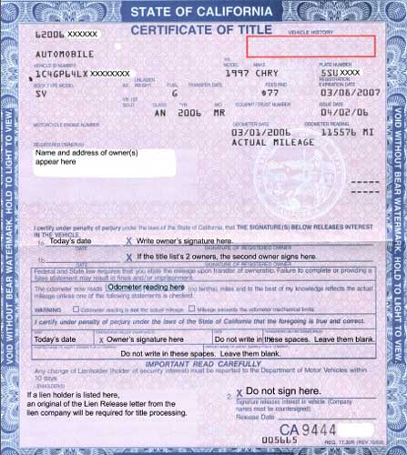
Decentralized property ownership

